Slide 1



Cyber Kill Chain
Eng. Mahmoud Hassan

Slide 2
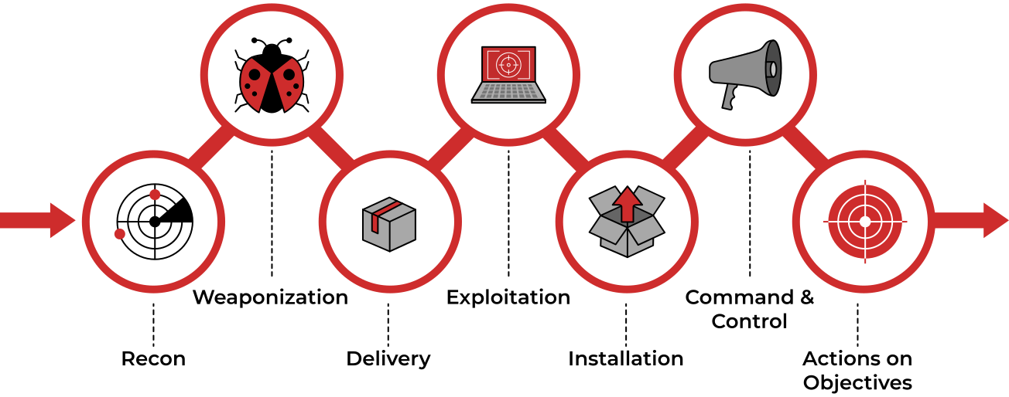
What is Cyber Kill Chain
The Cyber Kill Chain is a cybersecurity model help organizations understand and prevent cyber attacks. The model breaks down the stages of cyber attack to 7 stages, allowing defenders to identify and interrupt an attacker's progress.

Slide 3

Reconnaissance
Reconnaissance from the Attacker's Perspective:
Reconnaissance is the first phase where an attacker begins gathering information about the target system or victim. This phase is essentially the planning stage of an attack, where the attacker aims to fully understand the target before taking any action.
Reconnaissance Types
Passive Reconnaissance
Active Reconnaissance
The attacker interacts directly with the target system, increasing the risk of detection
The attacker gathers information without directly interacting with the target
WHOIS Lookup – To find domain registration details.
Google Dorking – Using advanced Google searches to find sensitive data.

Slide 4
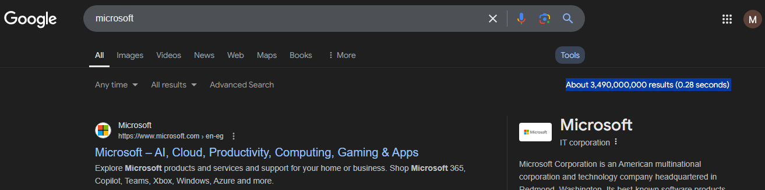
1. Google Search Engine
We will search on Microsoft then after the engine give you the results, see how many result appeared for you:
Company
Title
text
URL
You see above is the normal way for search on google
You see above is the normal way for search on google

Slide 5
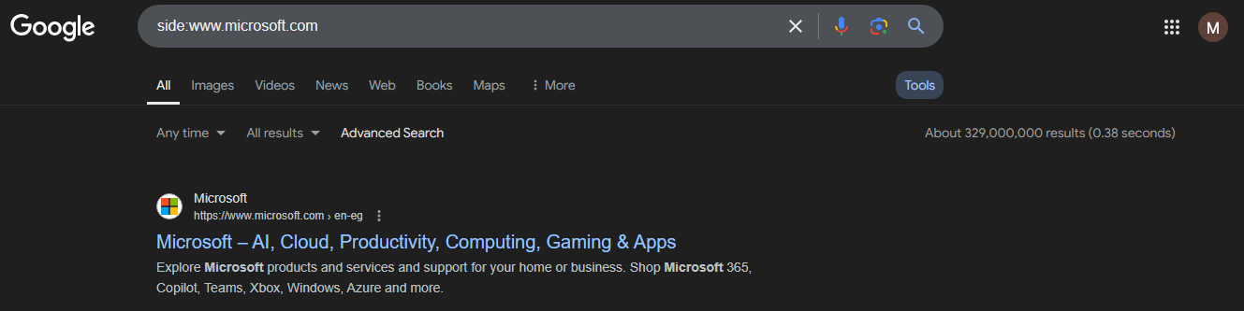
1. Google Advanced Search
Site: → Search within a specific website
01
Example: site:example.com "admin login"

Slide 6
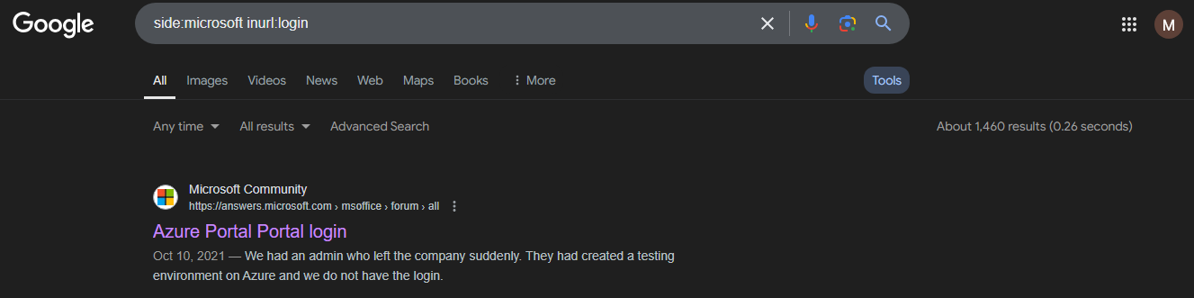
1. Google Advanced Search
inurl: → Search for pages that have specific words in the URL
02
Example: side:example inurl:login

Slide 7
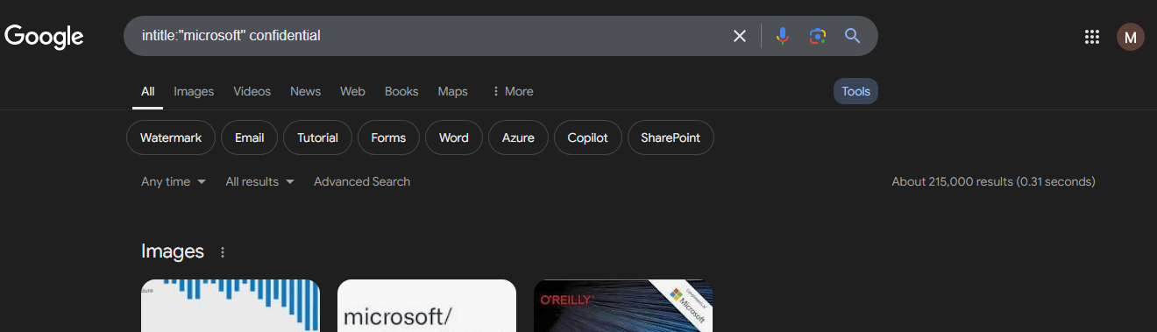
1. Google Advanced Search
intitle: → Search for pages that have a certain word in the title.
03
Example: intitle:"index of" confidential

Slide 8
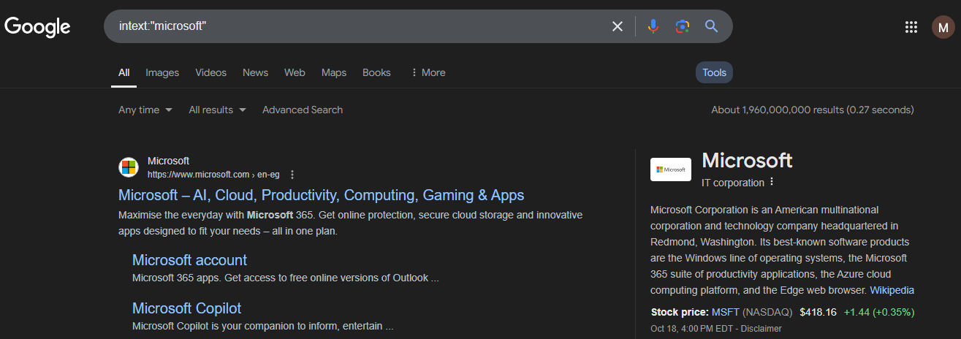
1. Google Advanced Search
intext: → Search for pages that have a certain word in the text.
04
Example: intext:"index of"

Slide 9
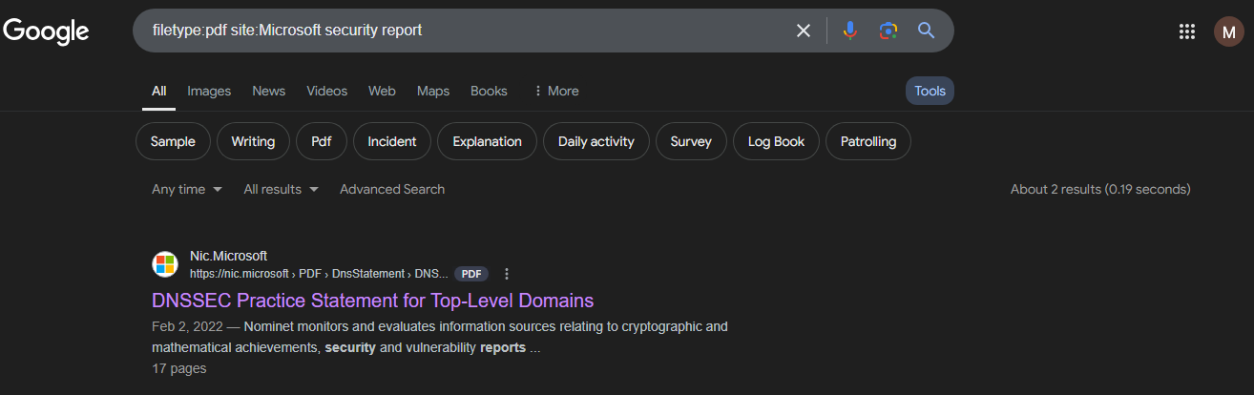
1. Google Advanced Search
filetype: → Search for specific file types like PDFs, DOCs, etc.
05
Example: filetype:pdf site:gov security report
Example: site:gov security report .pdf

Slide 10
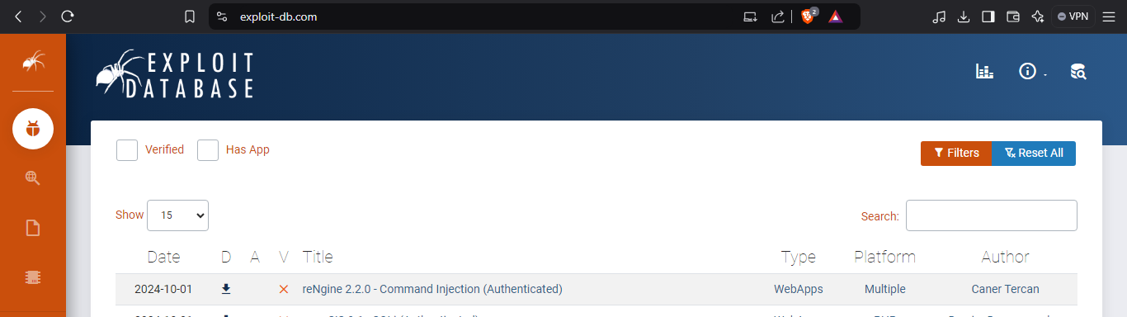
1. Google Hacking Database
Google Dorking (also known as Google hacking) involves using special search operators in Google to find specific results that aren’t easily accessible through normal search queries.
You can visit → www.exploit-db.com ← to see the database.

Slide 11



Thank you
+201116735630
mahmoudhassan2947@gmail.com
www.linkedin.com/in/mahmoud-hassan-b4400b1b7

